Slide 1


ASCEND Spring 2024 Symposium
Casa Grande Union High School

Slide 2

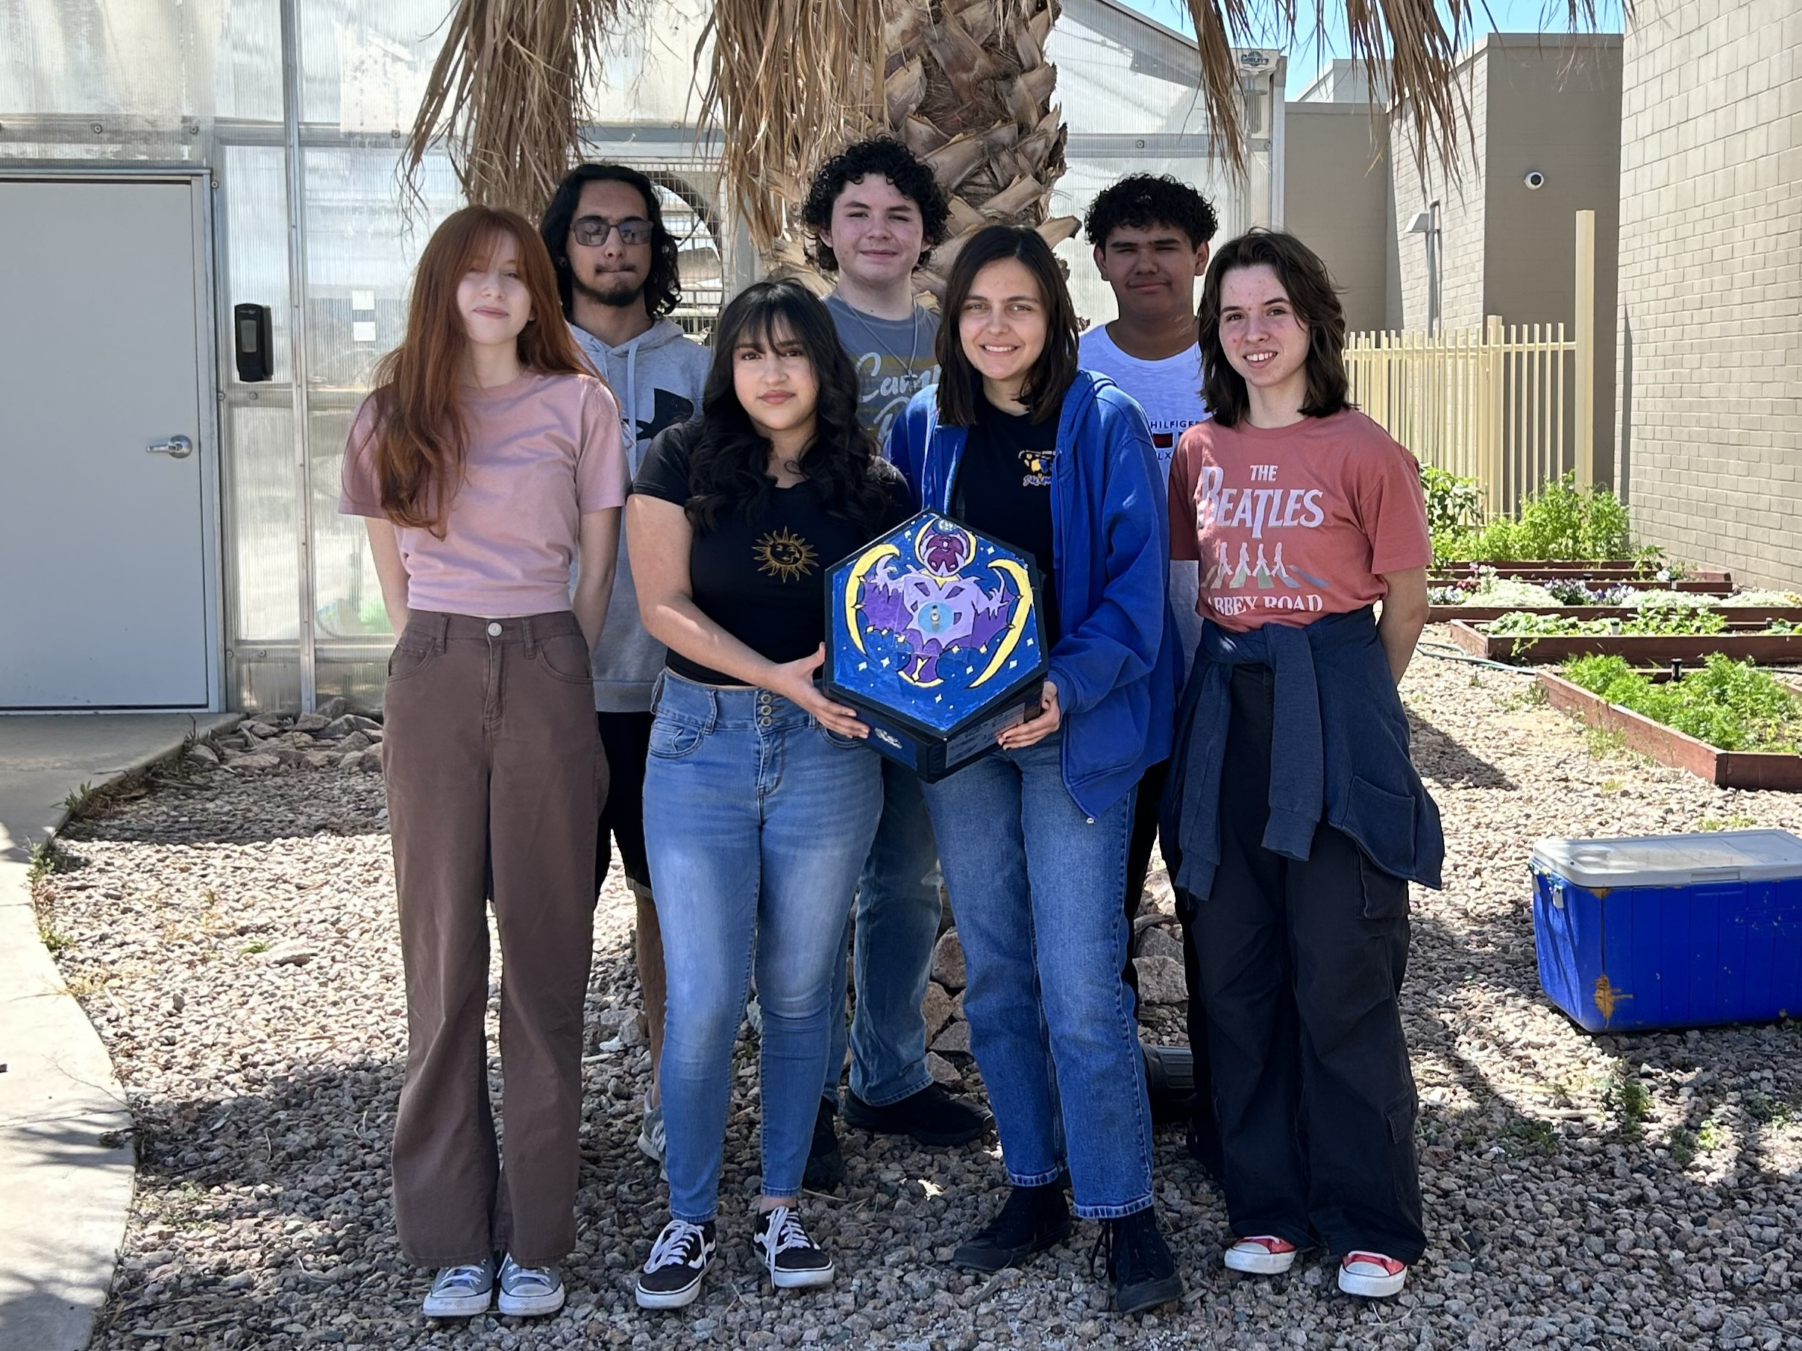
Team Members
Team Lead: Landri Howard
Electrical:
Emily Geen
Fabrication:
Elijah Ramirez
Melody Limon
Interns:
Zacheriah Buchanan
Aliceanna Villanueva
Programing:
Ethan Morgan
2/16

Slide 3


Mission Statement
The CGUHS Near Space Research Team will design, construct, test, and fly a high-altitude balloon payload to gather atmospheric data and 4K video during the flight.
3/16

Slide 4


What Is Ascend?
ASCEND is a project where students create a sensor payload which will fly on a high altitude balloon to collect data and video of the atmosphere
-
4/16

Slide 5


Fabrication
Team Members:
Elijah Ramirez
Melody Limon
Zacheriah Buchanan
Aliceanna Villanueva
5/16

Slide 6
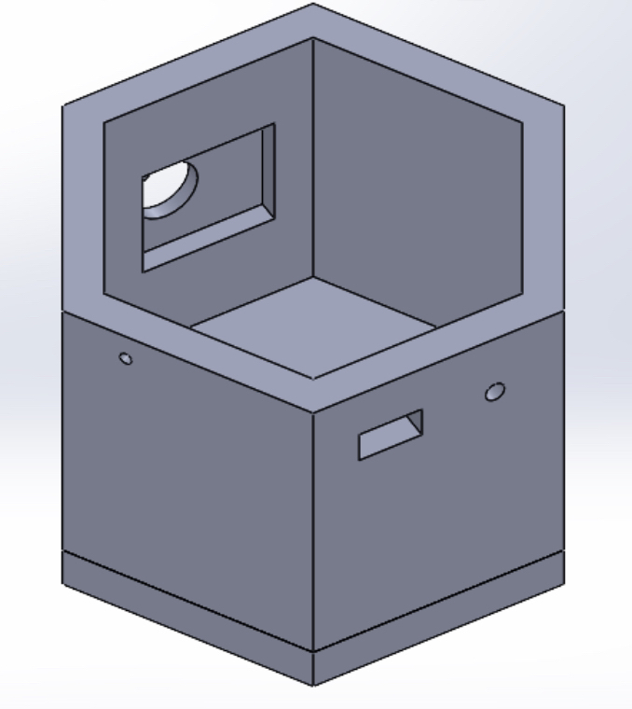
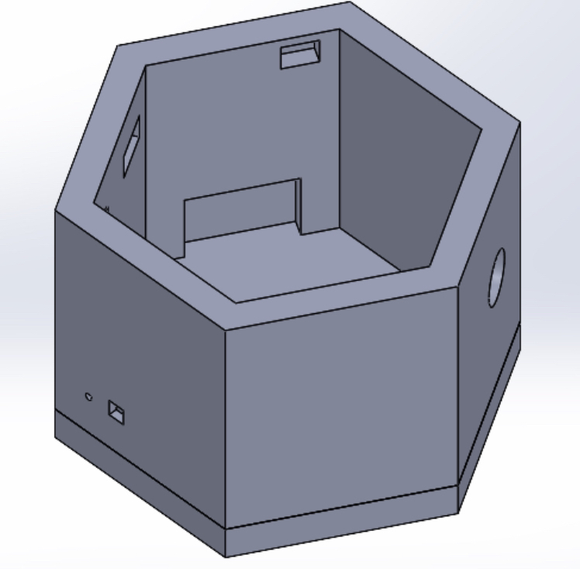
Fabrication
6/16

Slide 7
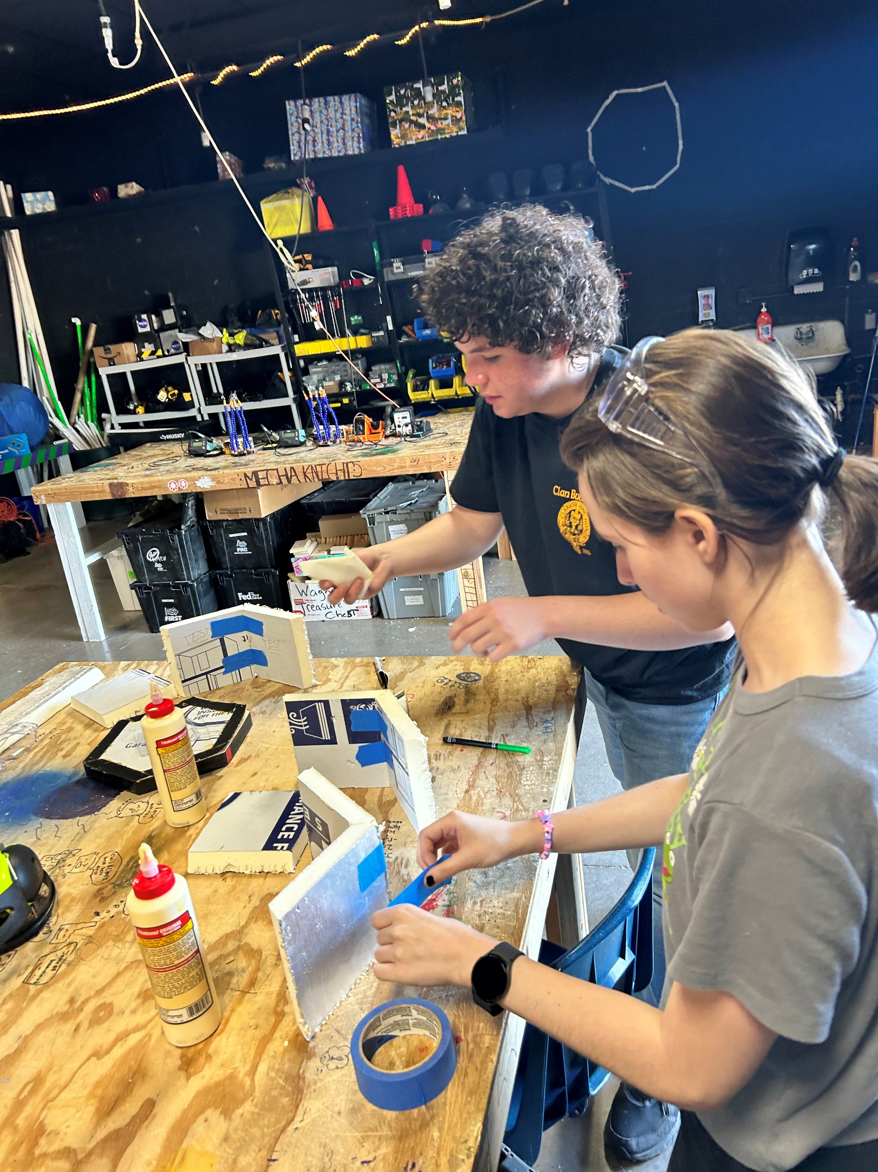
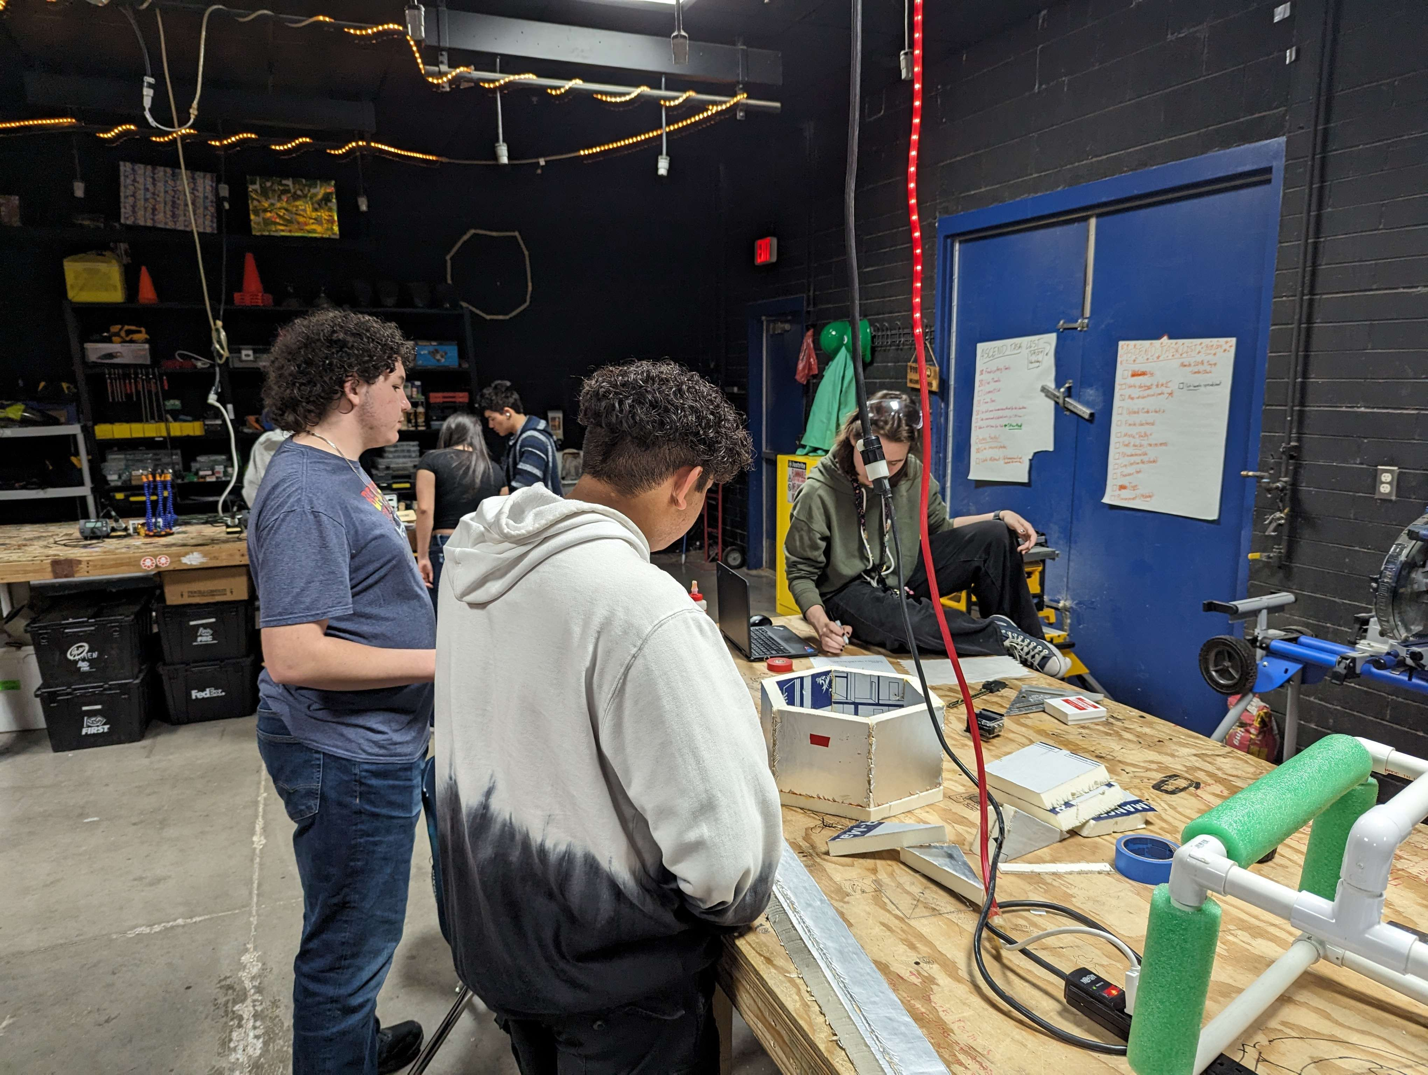
Fabrication
7/16

Slide 8
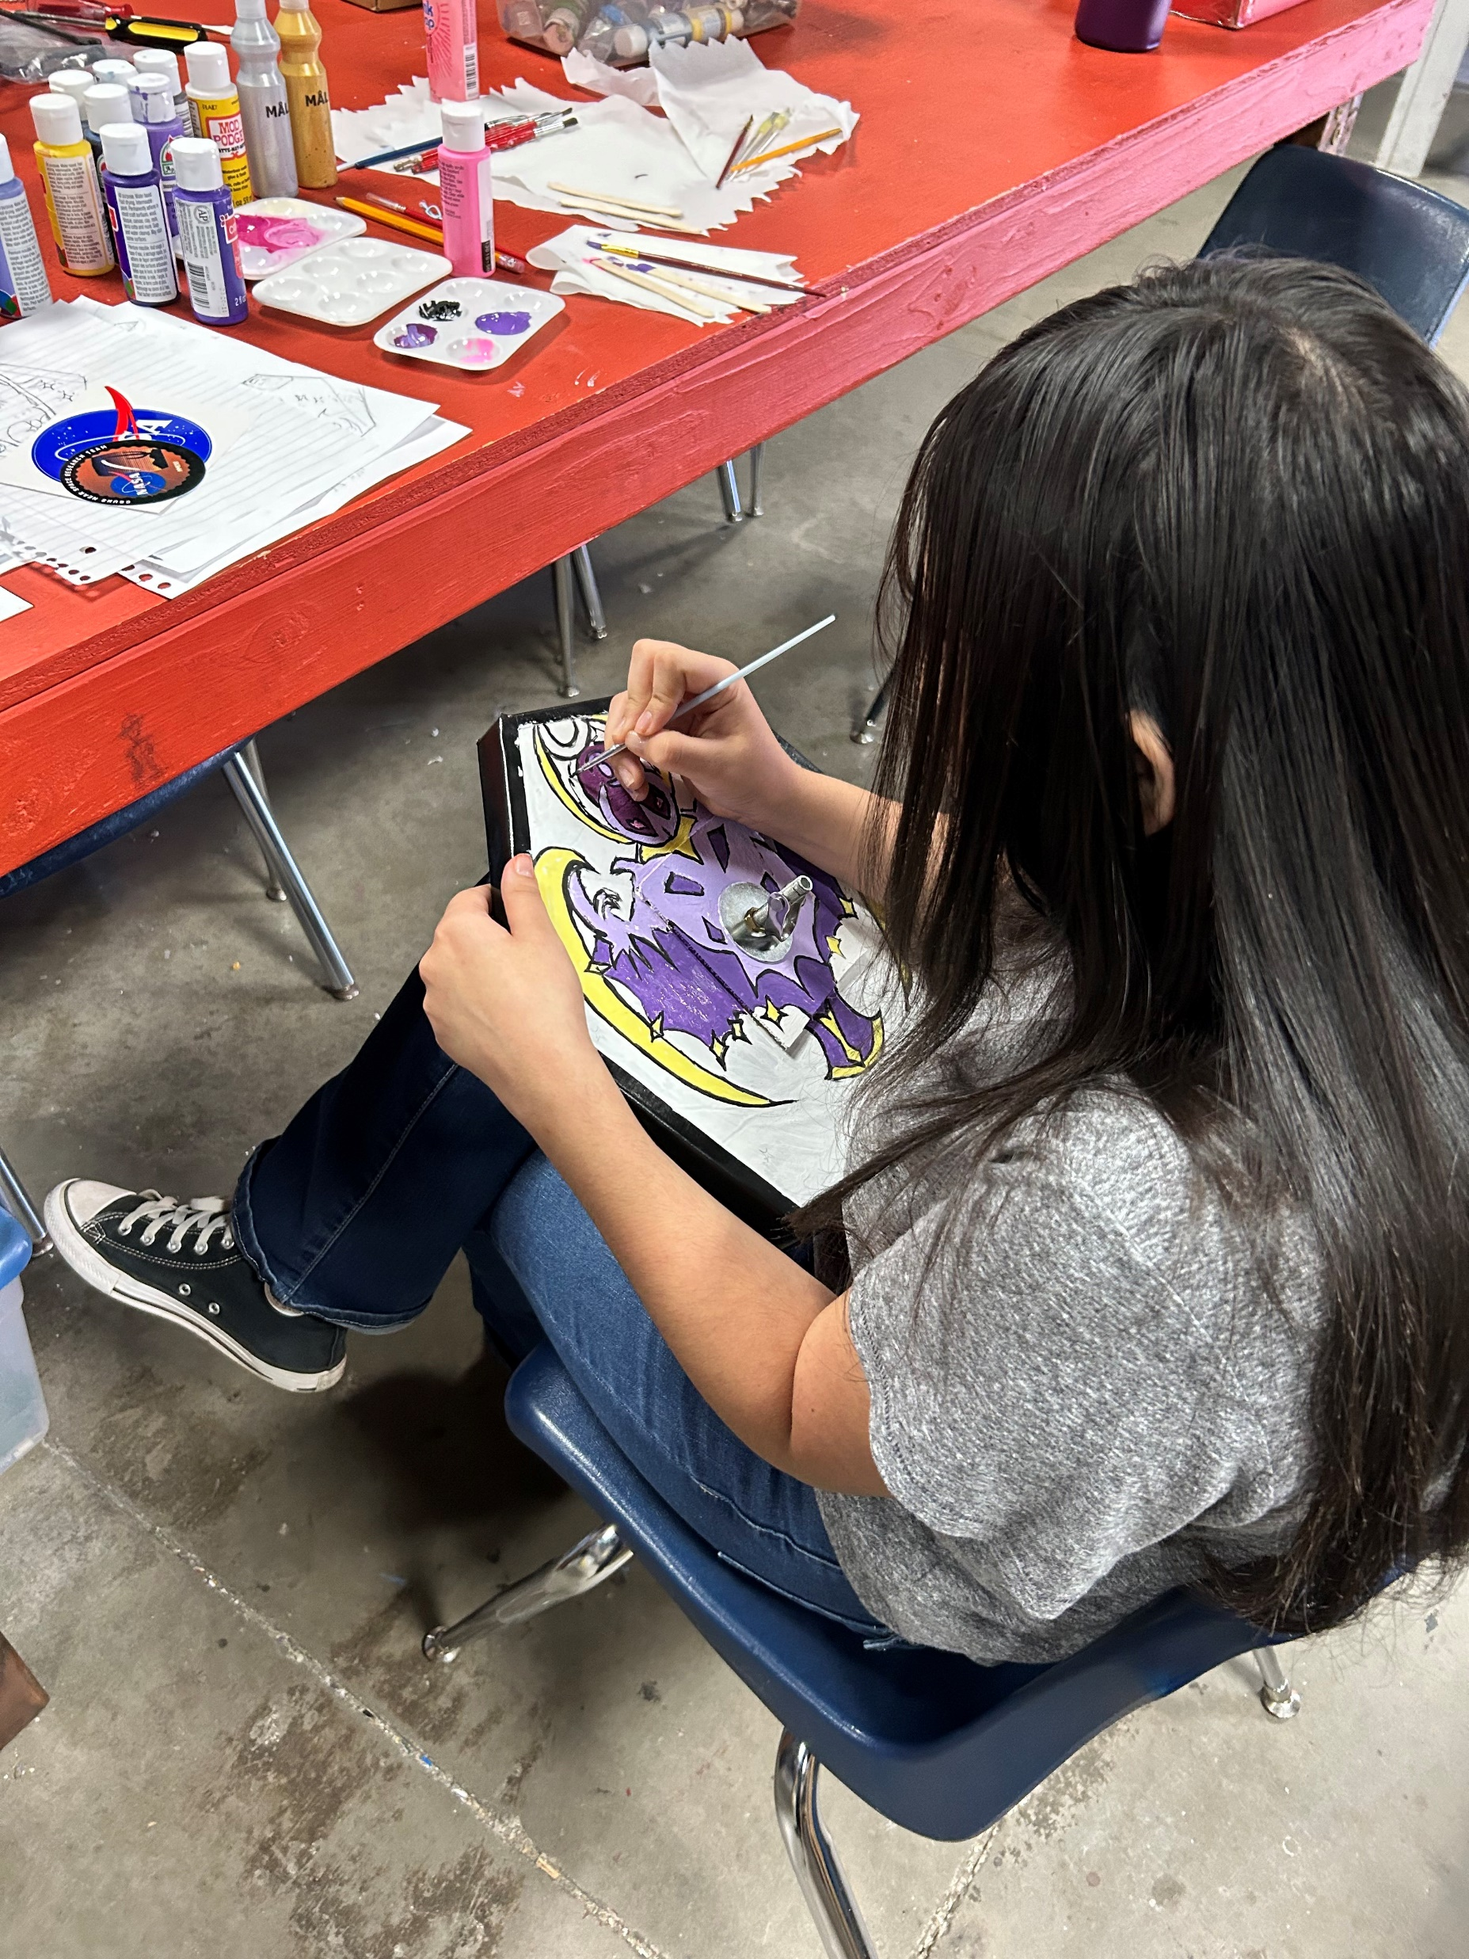
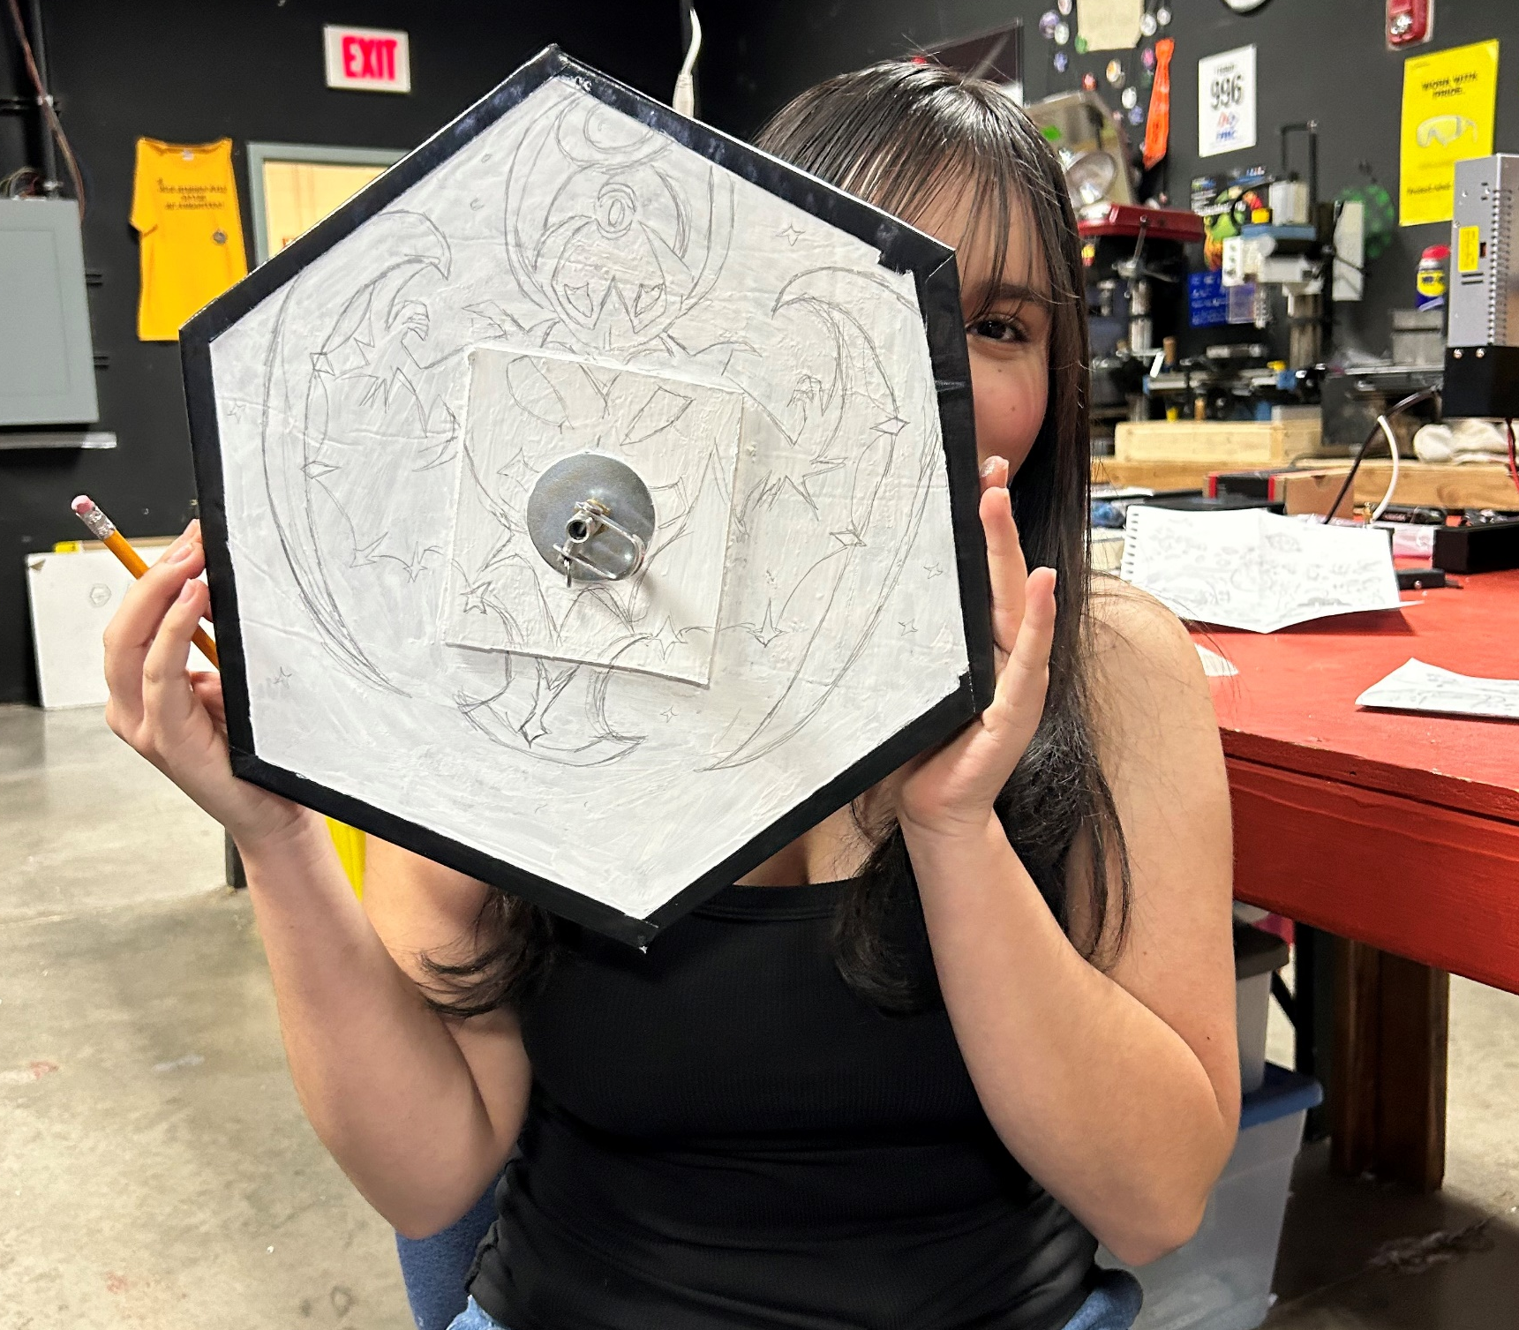
Fabrication
8/16

Slide 9




Programming
Team Members:
Ethan Morgan
9/16

Slide 10
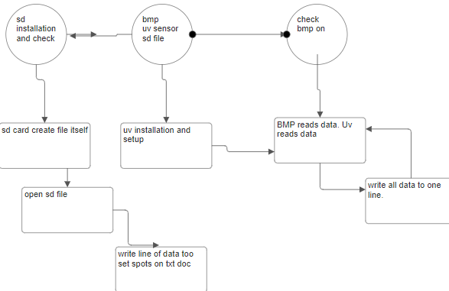
Programming
10/16

Slide 11


Electrical
Team Members:
Emily Geen
11/16

Slide 12
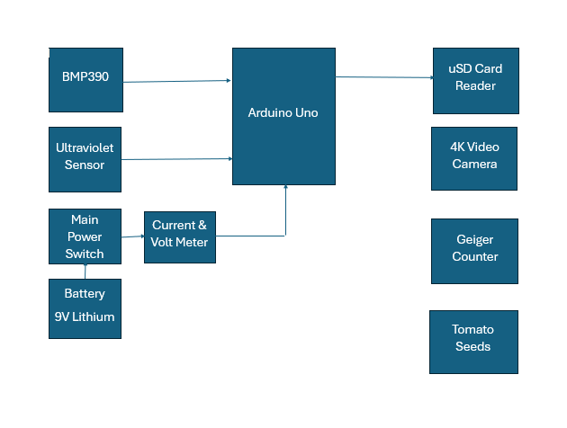
Electrical
12/16

Slide 13
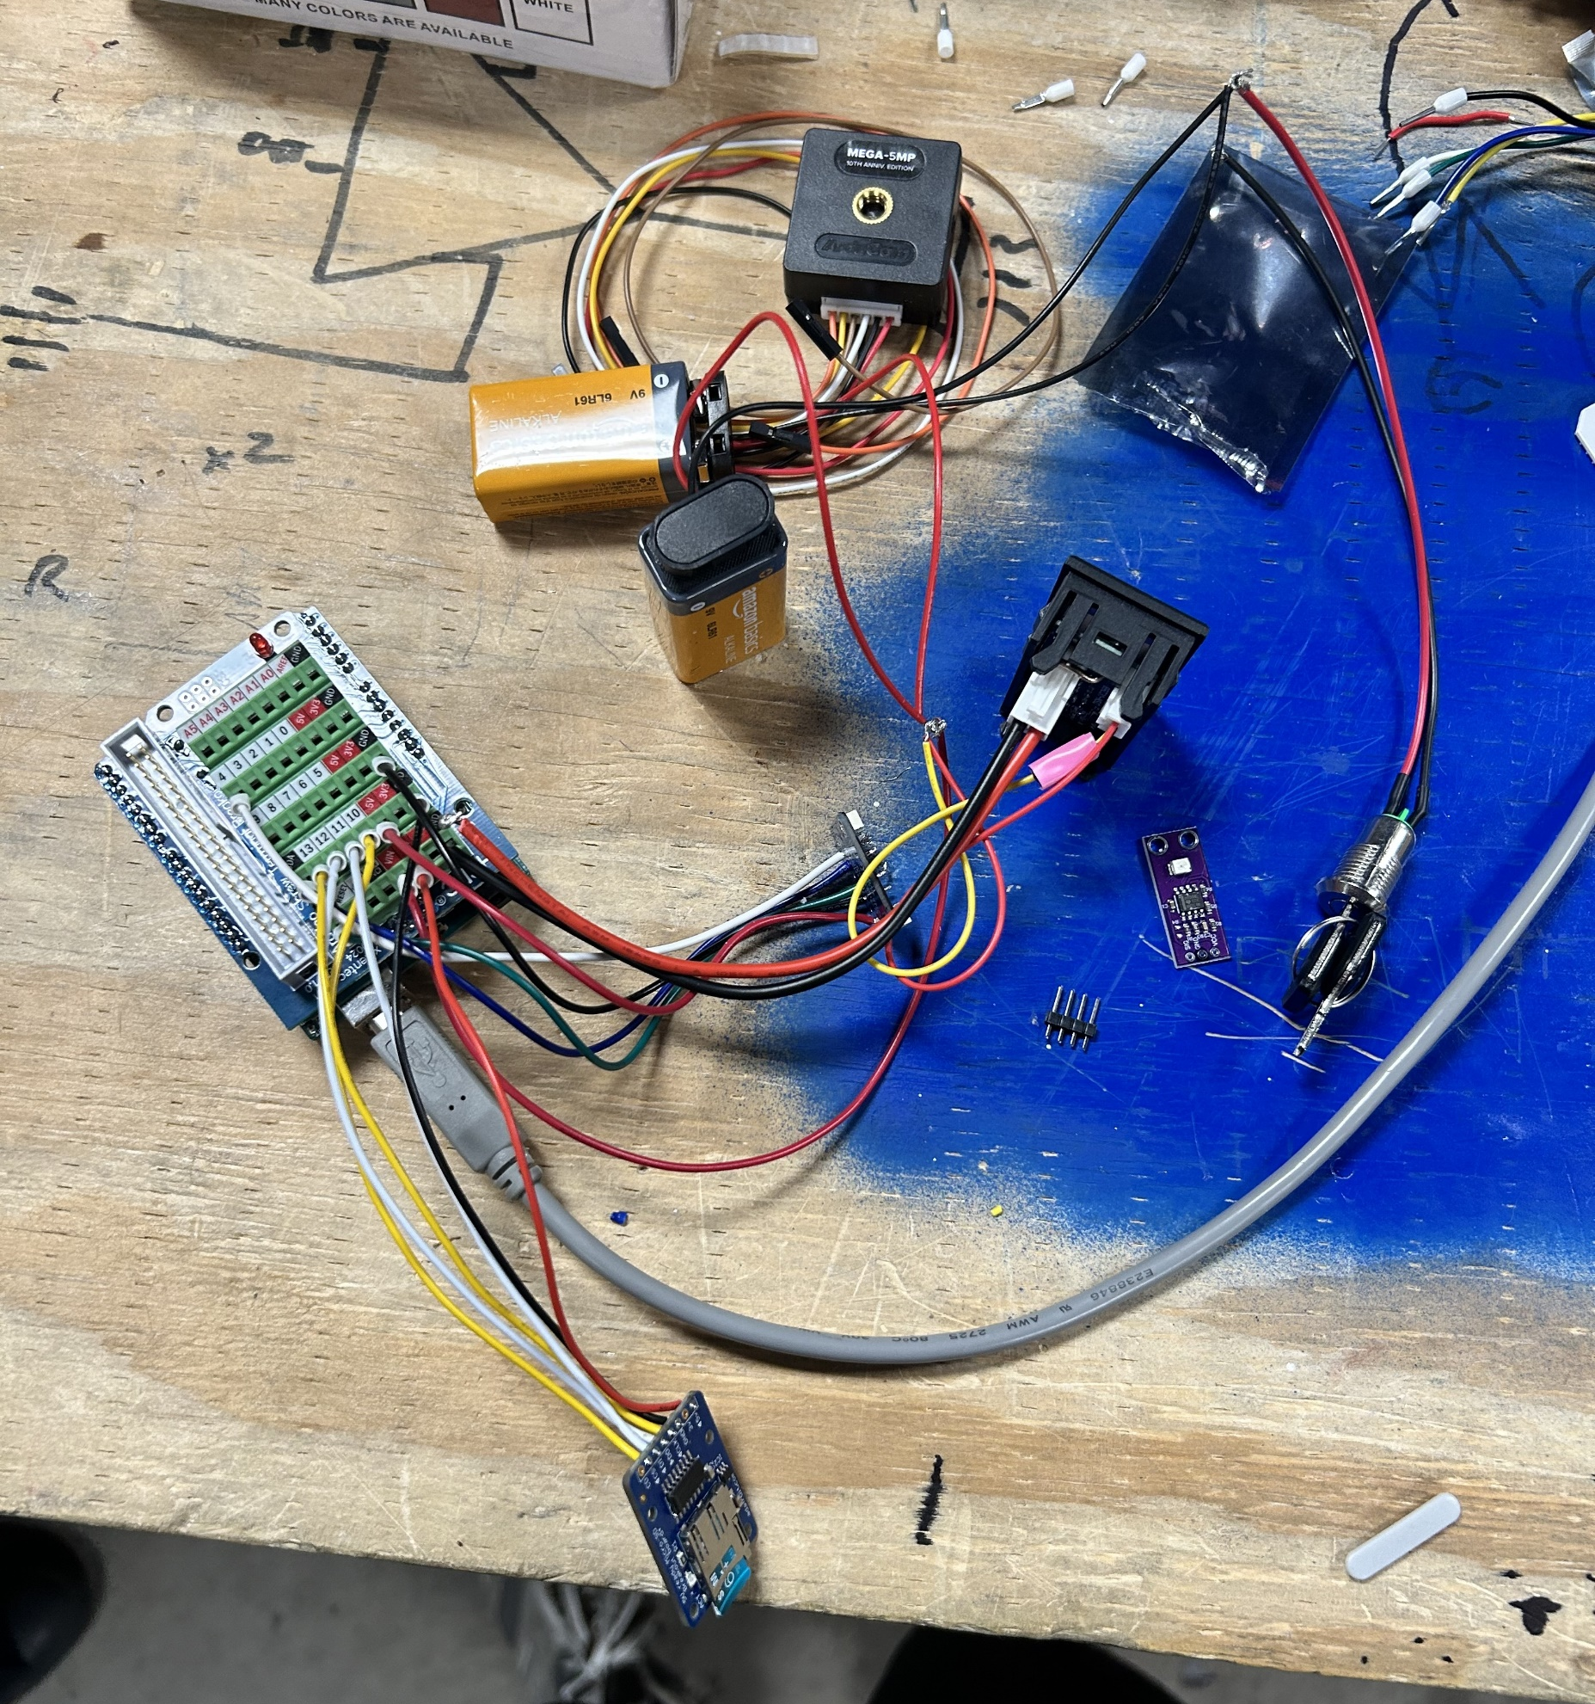
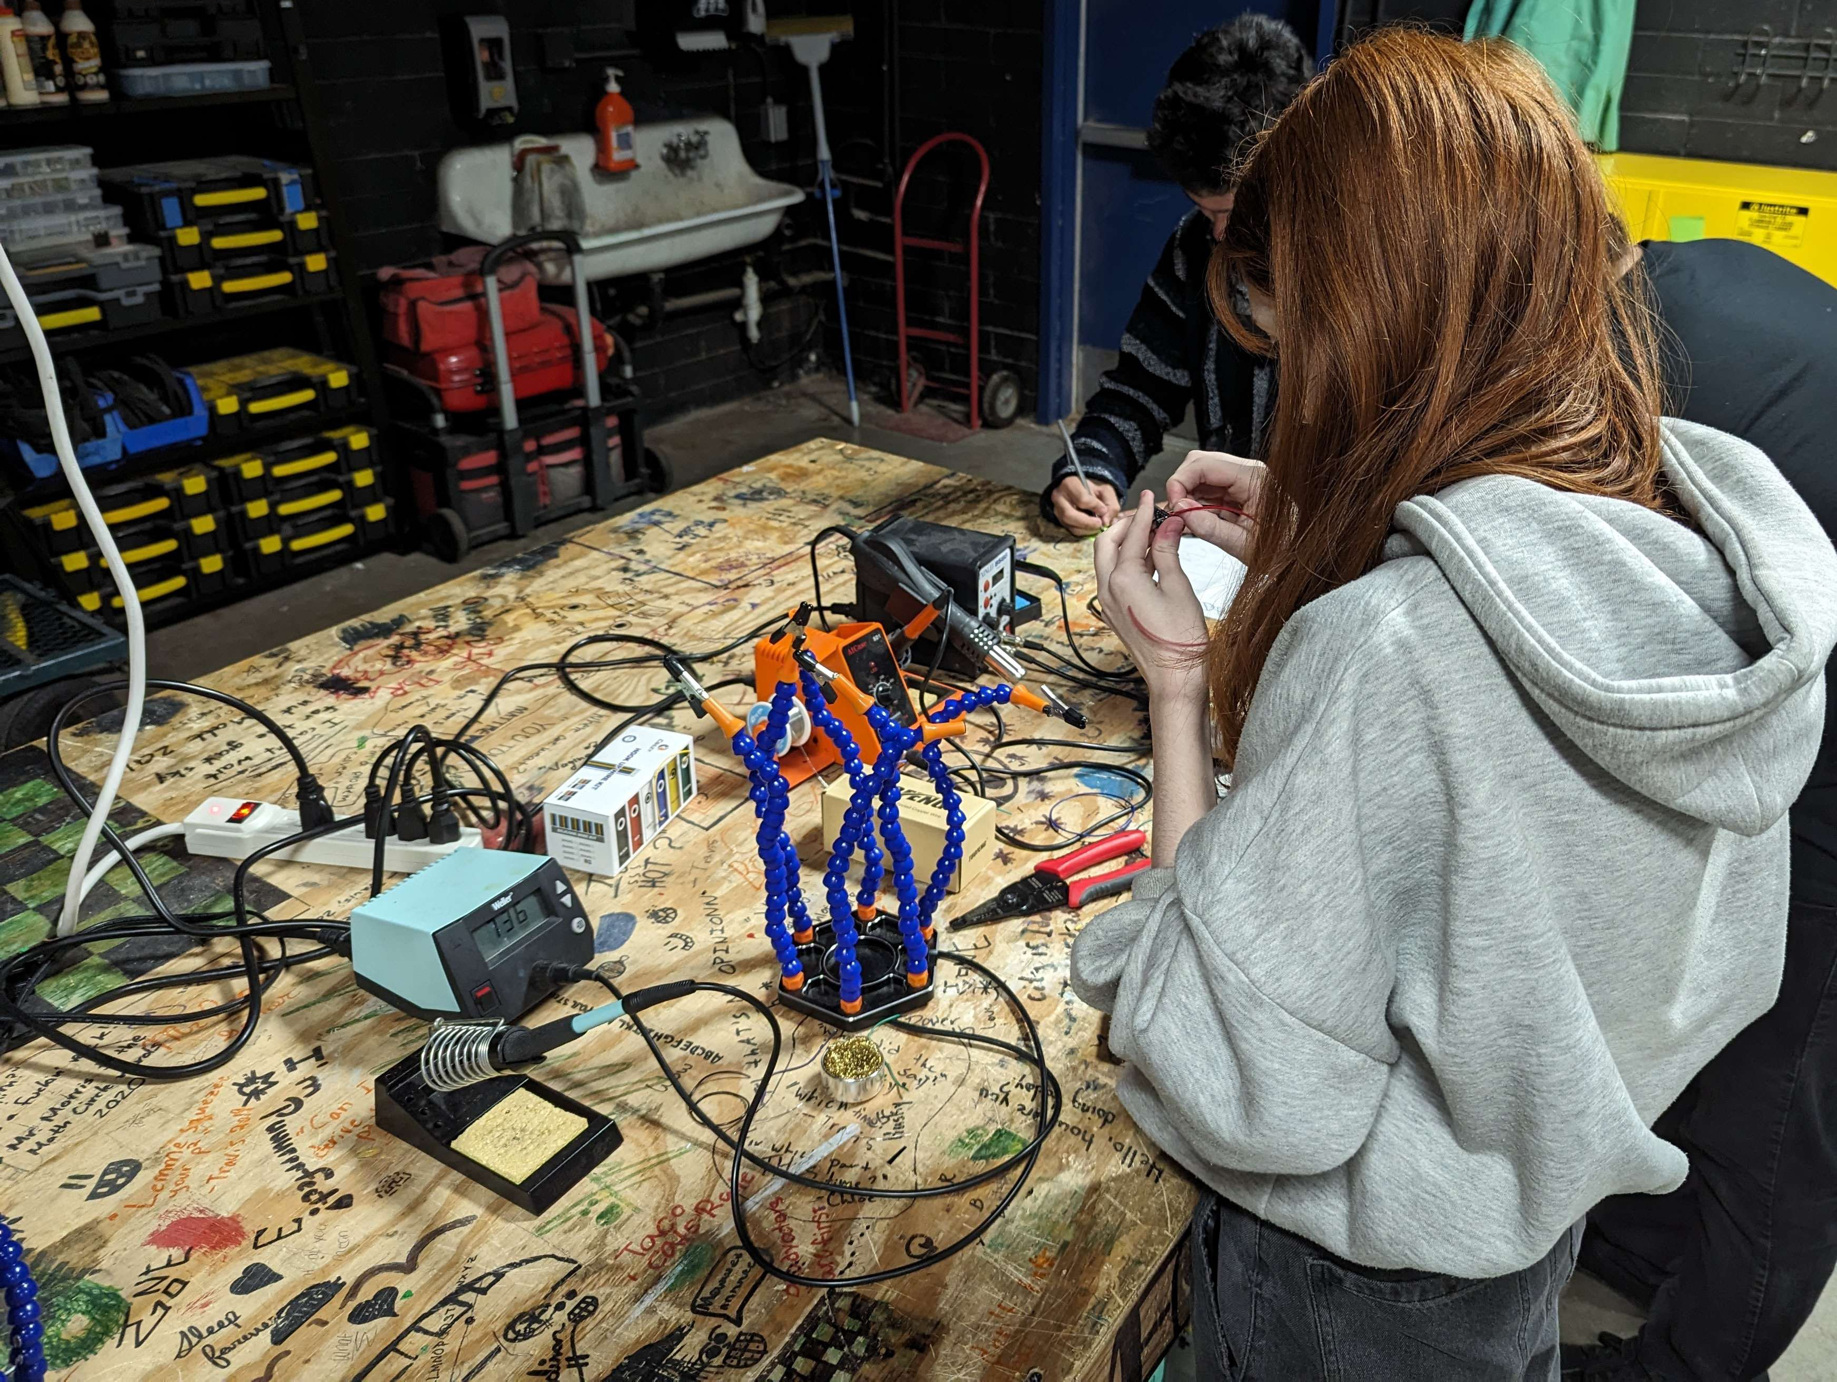
Electrical
13/16

Slide 14
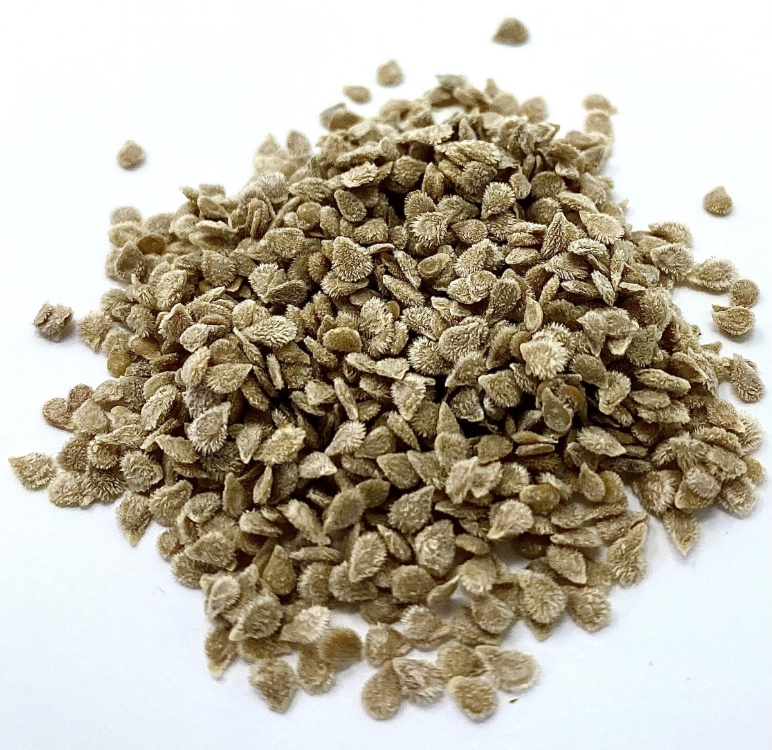
Bioscience Experiment
14/16

Slide 15

Acknowledgements
Michelle Coe
Manager,
Arizona/NASA Space Grant Program
University of Arizona
Clayton G. Jacobs, KJ6QJS
President, Arizona Near Space Research www.ansr.org
Stephen Thomas, KE7TLS,
Vice President,
Arizona Near Space Research
Shirley Campbell
Assistant Director
National Space Grant Foundation
John Morris
Certified Educator
Engineering | Software and App Design
CGUHS Poster #6
15/16

Slide 16




Thank you!

